Slide 1
The Angst of Being a Christian

Slide 2
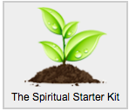
At the end of the Spiritual Starter Kit, the person gets one more email which reads…

Slide 3
Having a relationship with God can be a wonderful experience. Or extremely frustrating. There are land mines. I remember the first year or so after asking Jesus into my life. I loved getting to know God. I'd spend hours in the Gospels, captivated by Jesus' life and how he interacted with people. The more I read, the more I appreciated him. But I also found myself reading things in the Bible that took me off-guard. Certain actions were identified as *sins* that I had never viewed that way! I also found commands like: "be patient, tenderhearted, forgiving,” which were far easier to read than to do. In frustration, I thought, "It was much easier being an atheist." Then, over the next several months, I started feeling like I owed God payback for all the great things he was doing in my life. I thought, "Now that I know God is there, I should be talking to him more. I should be reading the Bible more. I should be talking to my friends who don't know him. I should be, I should be...."

Slide 4
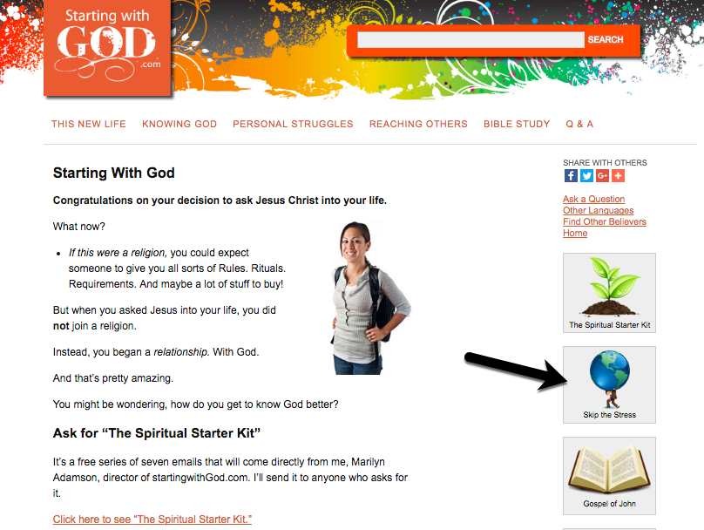
Sign up for Skip the Stress.

Slide 5
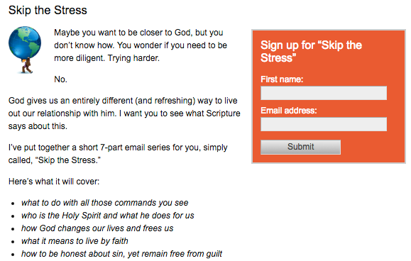

Slide 6
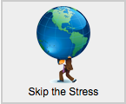
has a HUGE impact in many peoples’ lives.

Slide 7
The last three emails were so obviously necessary and undeniably valuable for my salvation. I don't want you to forget how important these lessons and teachings you're providing me are at this point in my life. ~Tremayne

Slide 8
I’m now understanding what it means to have a relationship with God. For the first time in my life I genuinely want to know more about God. No one is guilt tripping me to do so. I've never felt so at peace. Thank you. ~Angelina

Slide 9
I just wanted to email you to let you know how thankful I am for your emails that you send out. They have been a wealth of help for me with my new walk with Christ and I look forward to getting them. ~ Leslie

Slide 10
“These series have helped me understand the bible even more deeply. The simplicity with which you open up hidden secrets is actually astounding.”

Slide 11
Wooooh, it freed me! What a wonderful feeling. ~ Eric

